Slide 1
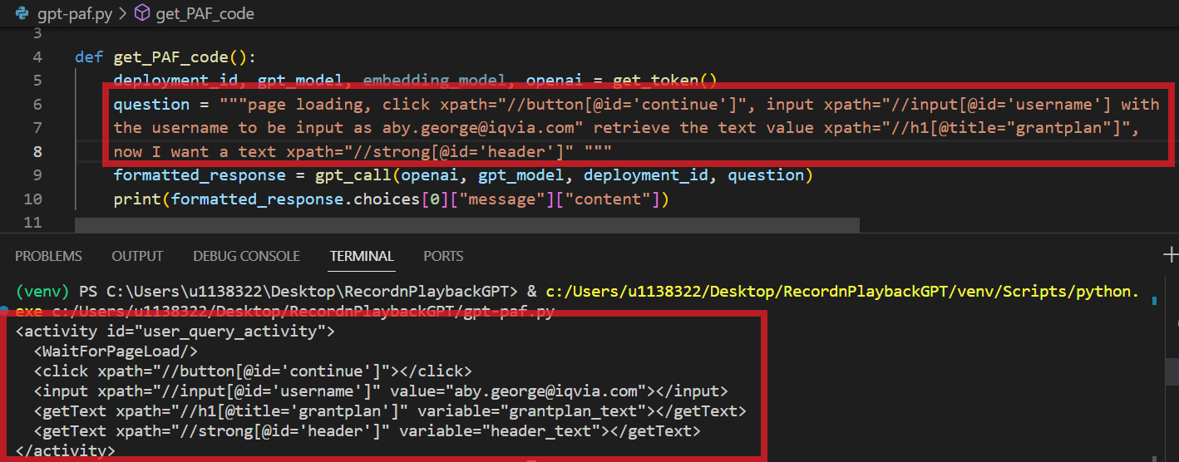
Here, GPT generates PAF code in the correct format referring to the user manual. It automatically generates unique and appropriate id’s, names, labels, etc., based on the context.
Here the input is a combination of UI locators and natural language input.
In the next slide, we can look at how we can automatically acquire the UI locators some of the natural language input.
Some crude input consisting of UI locators and natural language.
GPT generated output – (PAF Code) in the correct format with unique and appropriate names and labels.

Slide 2
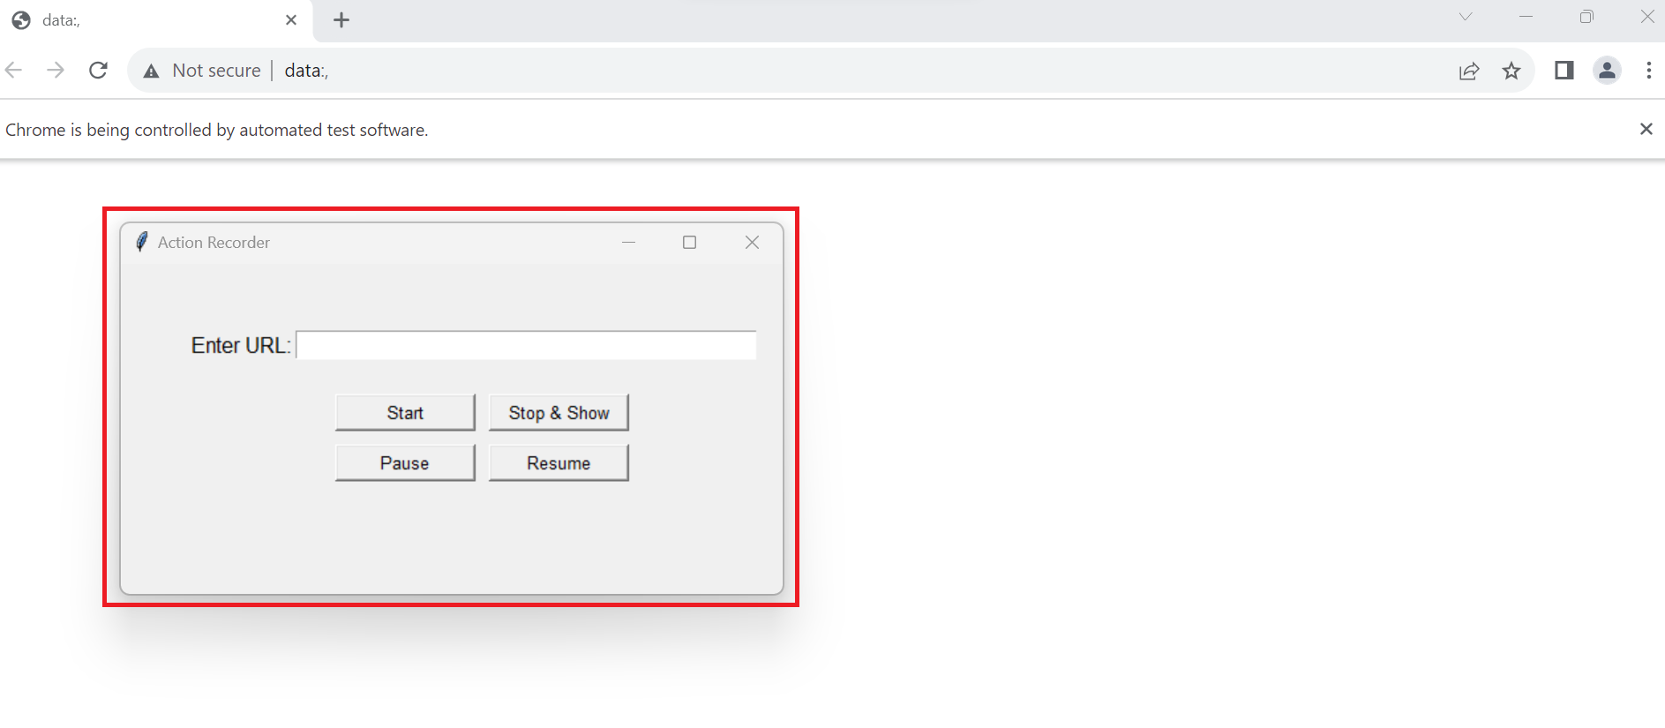
As a test is performed manually (just a single time is required) – the action recorder captures all the UI locators required in the correct order along with the action that is being performed and stores it.
This in turn can be fed as input to the GPT code generator to produce the required code.
Some complex actions though, cannot be simply captured – like validation, pass messages, checking calculations, comparing texts, etc.
This is where the natural language processing capabilities of GPT come into play
This action recorder records the UI actions performed and captures the required UI locators sequentially as the tests are being manually performed (this is a one-time process).

Slide 3
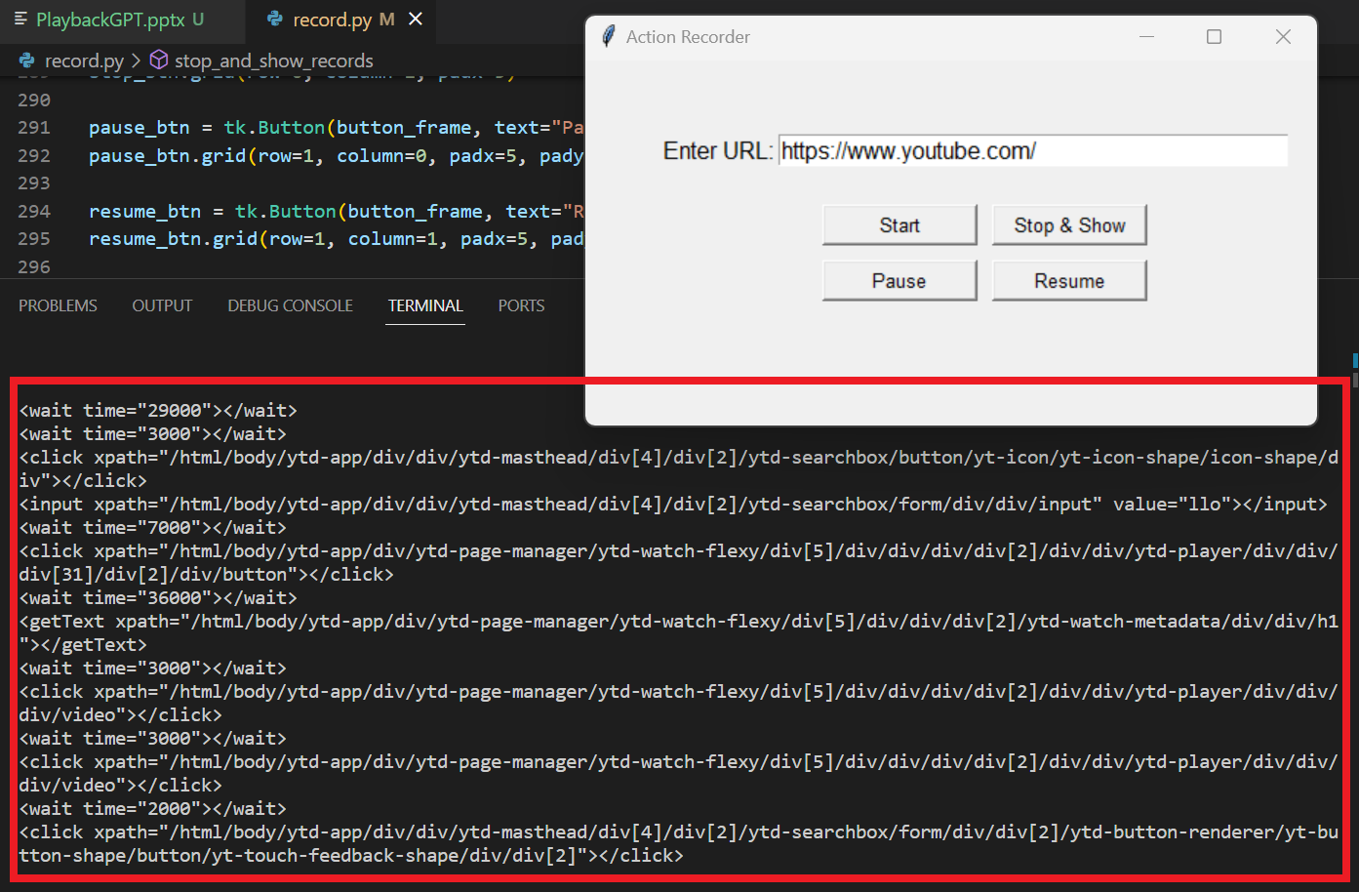
Here is a sample of some code generated by the action recorder alone – it generates the xpaths (UI locator), wait times, input values, in the correct order – this is crude PAF code.

Slide 4
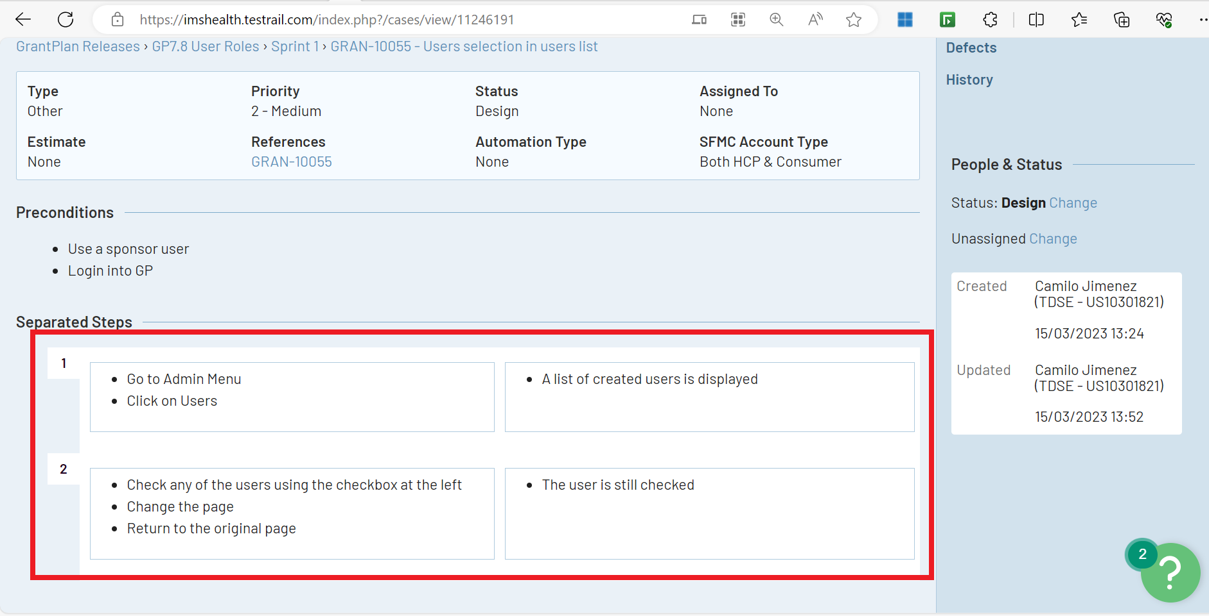
These are the test steps performed manually and written down by reviewers which are passed down to the PAF code developers .
This process can be cut short by simply taking the actions the reviewer performs to conduct the test manually in conjunction with the test steps written by them to directly generate PAF script (or possibly, other custom framework code as well).

